Slide 1


Classification System

Slide 2
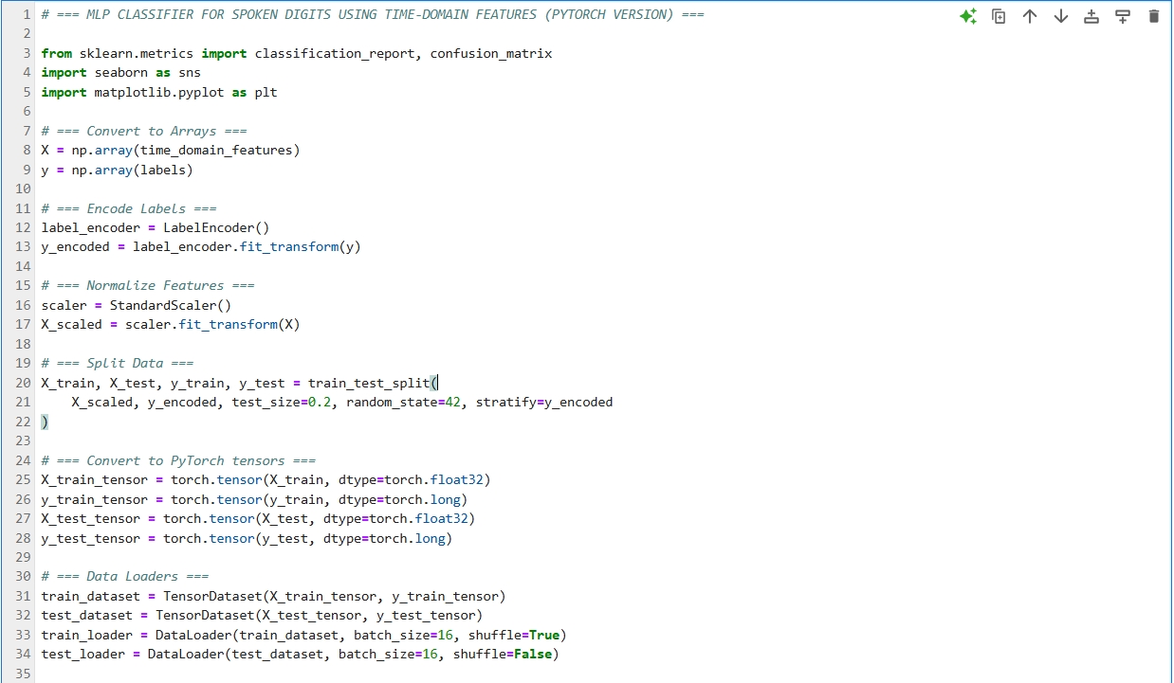
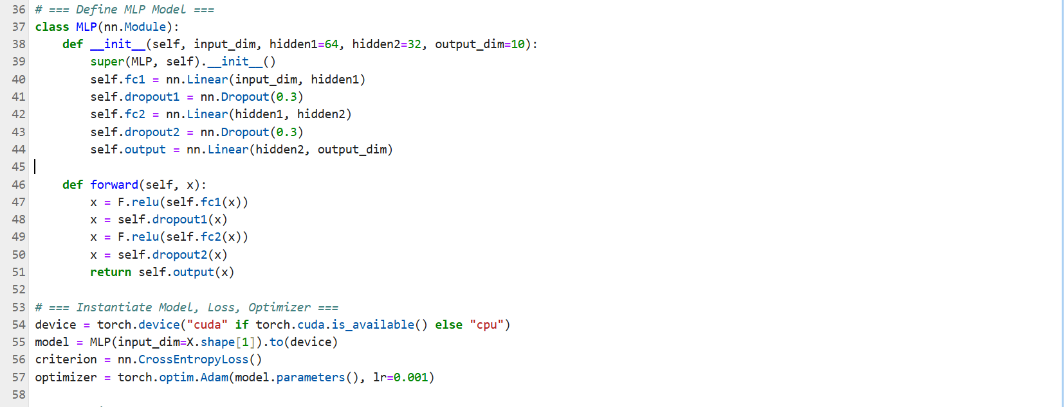

MLP classifier – Time domain features

Slide 3
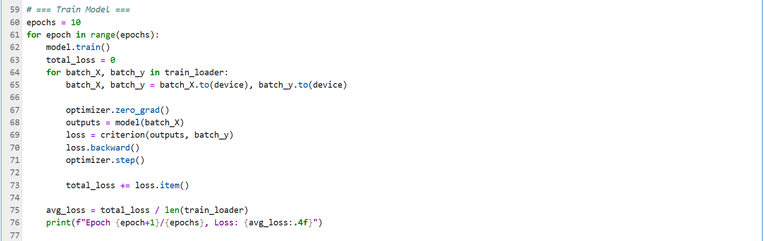
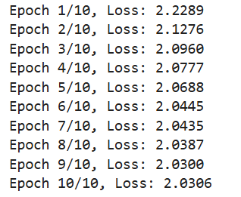

MLP classifier – Time domain features

Slide 4
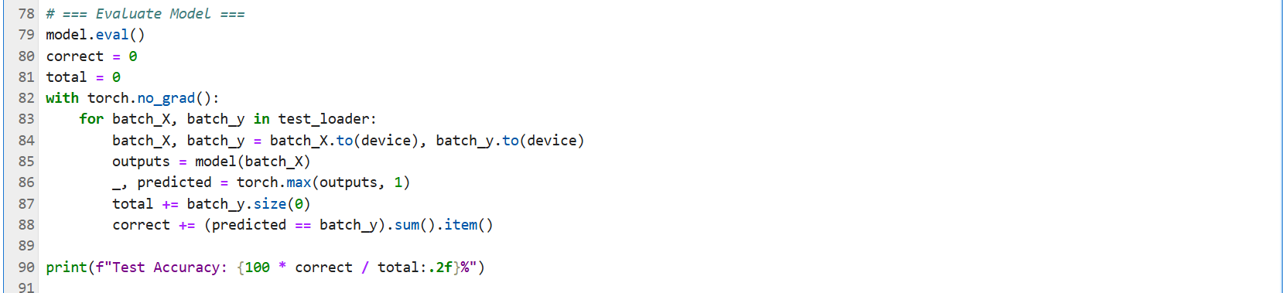

MLP classifier – Time domain features

Slide 5
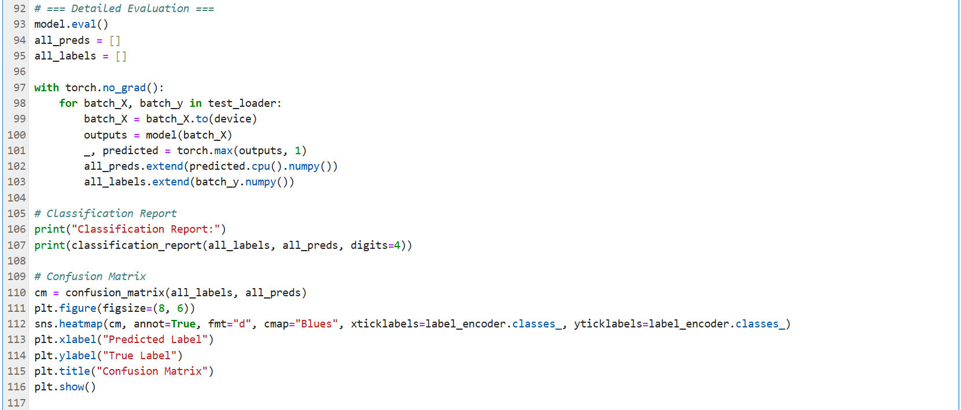

MLP classifier – Time domain features

Slide 6
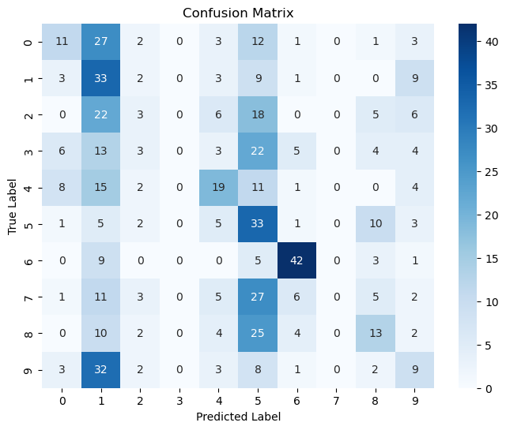
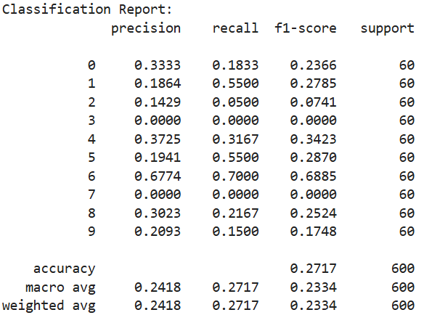

MLP classifier – Time domain features

Slide 7
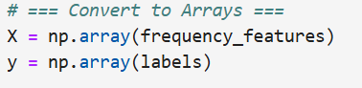

MLP classifier – Frequency domain features

Slide 8

MLP classifier – Frequency domain features

Slide 9
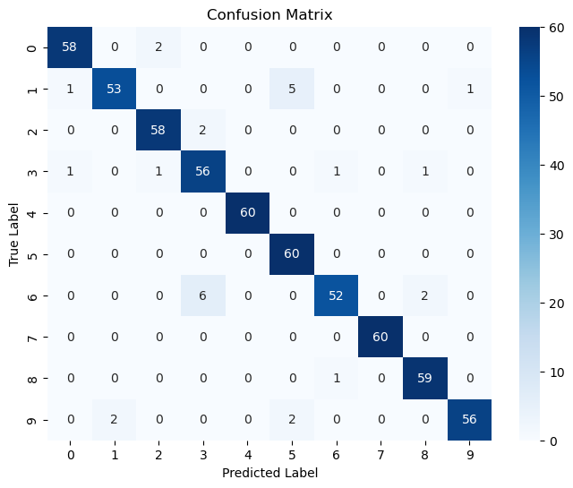
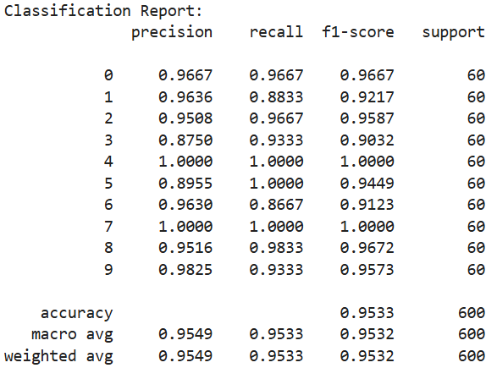

MLP classifier – Frequency domain features

Slide 10
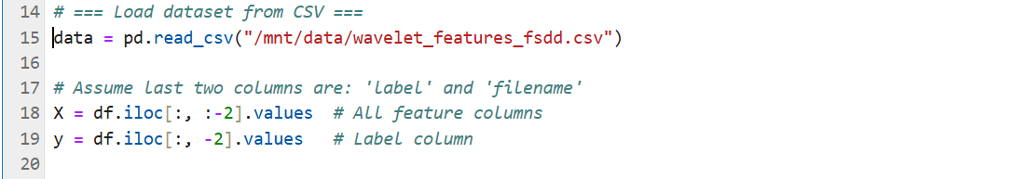

MLP classifier – Wavelet domain features

Slide 11

MLP classifier – Wavelet domain features

Slide 12
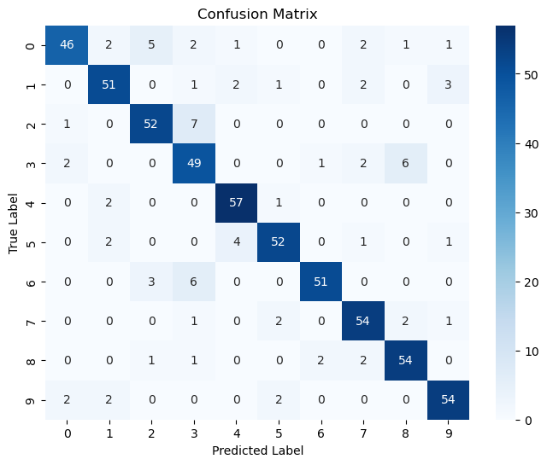
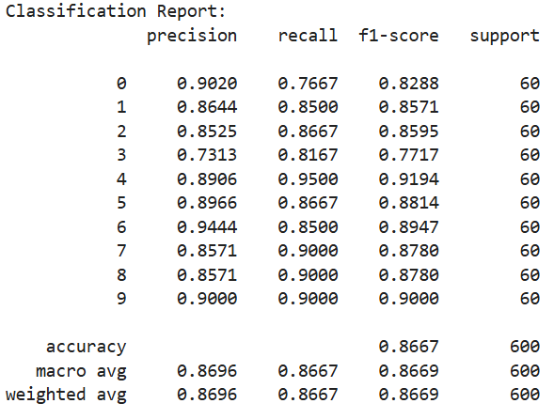

MLP classifier – Wavelet domain features

Slide 13

Conclusion
Time-domain features are simple/basic for audio recognition
Poor performance
Fail to identify digits 3 and 7
ZCR and Energy are not enough
Frequency-domain features excel in audio recognition
Excellent performance
Slight deviations for digits 1, 3, 6, and 9
Bandwith, centroid, and MFCCs form the toolbox for speech applications
Wavelet-based features also excel, but not as good as frequency features
Strong performance
Noticeable deviations for digits 0, 3, and 6
Approximation and detail coefficient help in audio recognition tasks

